Slide 1
Types of Annotation
Annotation
Marker Annotation
Single-Value Annotation
Multi-Value Annotation

Slide 2
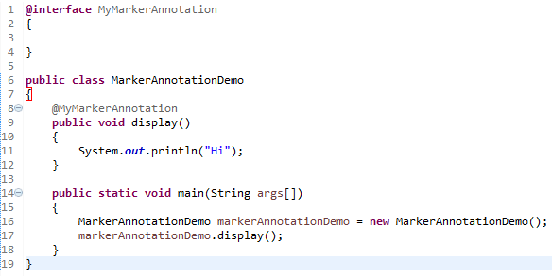
Types of Annotation
An annotation that has no method, is called marker annotation.
The @Override and @Deprecated are marker annotations.

Slide 3
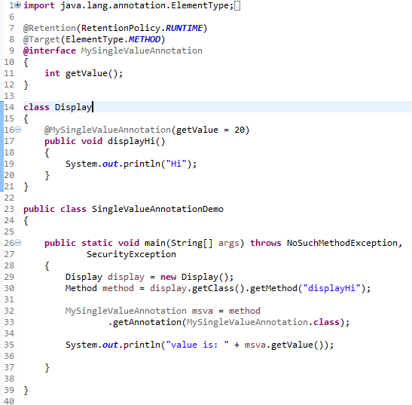
Types of Annotation
An annotation that has one method, is called single-value annotation.
Code to apply the single-value annotation.

Slide 4
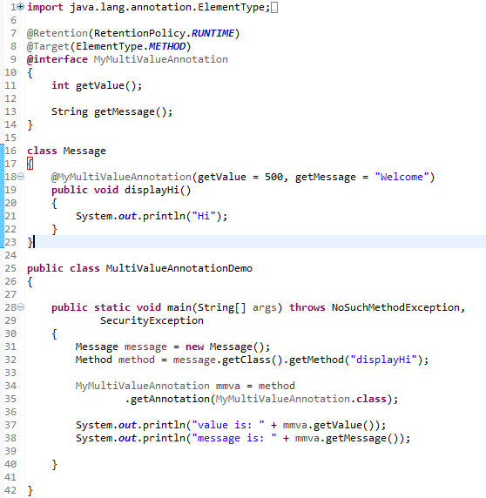
Types of Annotation
An annotation that has more than one method, is called Multi-Value annotation.
Code to apply the multi-value annotation.

